Slide 1
Sprint 1 Delivery
Group 1 - Alex, Angel, Atanas, Stoyan, Tsanko
Notes:
Getting up to speed with Grafana and experiencing the problems ourselves.
Began research into different requirements - performance, usability and expansion. We also looked into the queries that you provided.

Slide 2
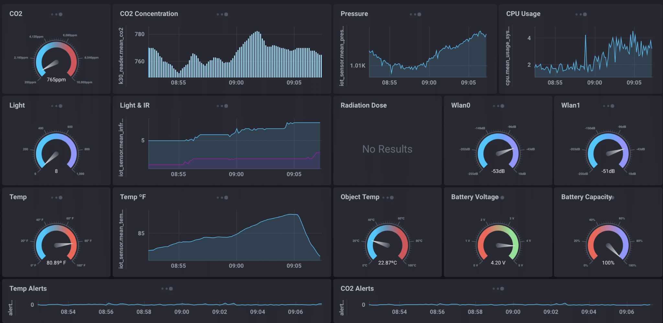
Grafana Alternatives
Chronograf
Datadog
Prometheus
Zabbix
Kibana
Best Choice | Grafana
Best Alternative | Chronograf InfluxDB

Slide 3
Database optimization research
Proper indexation
Using proper data types
Database normalization
Stored procedures
Views vs Common Table Expressions
Notes:
Indexation can drastically improve query performance (looks like it is covered)
Using proper data types - helps reduce the amount of storage needed, improves query performance as values don’t have to be converted when comparing.
Database normalization - everything except 5th Normal Form - 2 tables in 1
Stored procedures - sql queries stored in the db, increases performance,

Slide 4
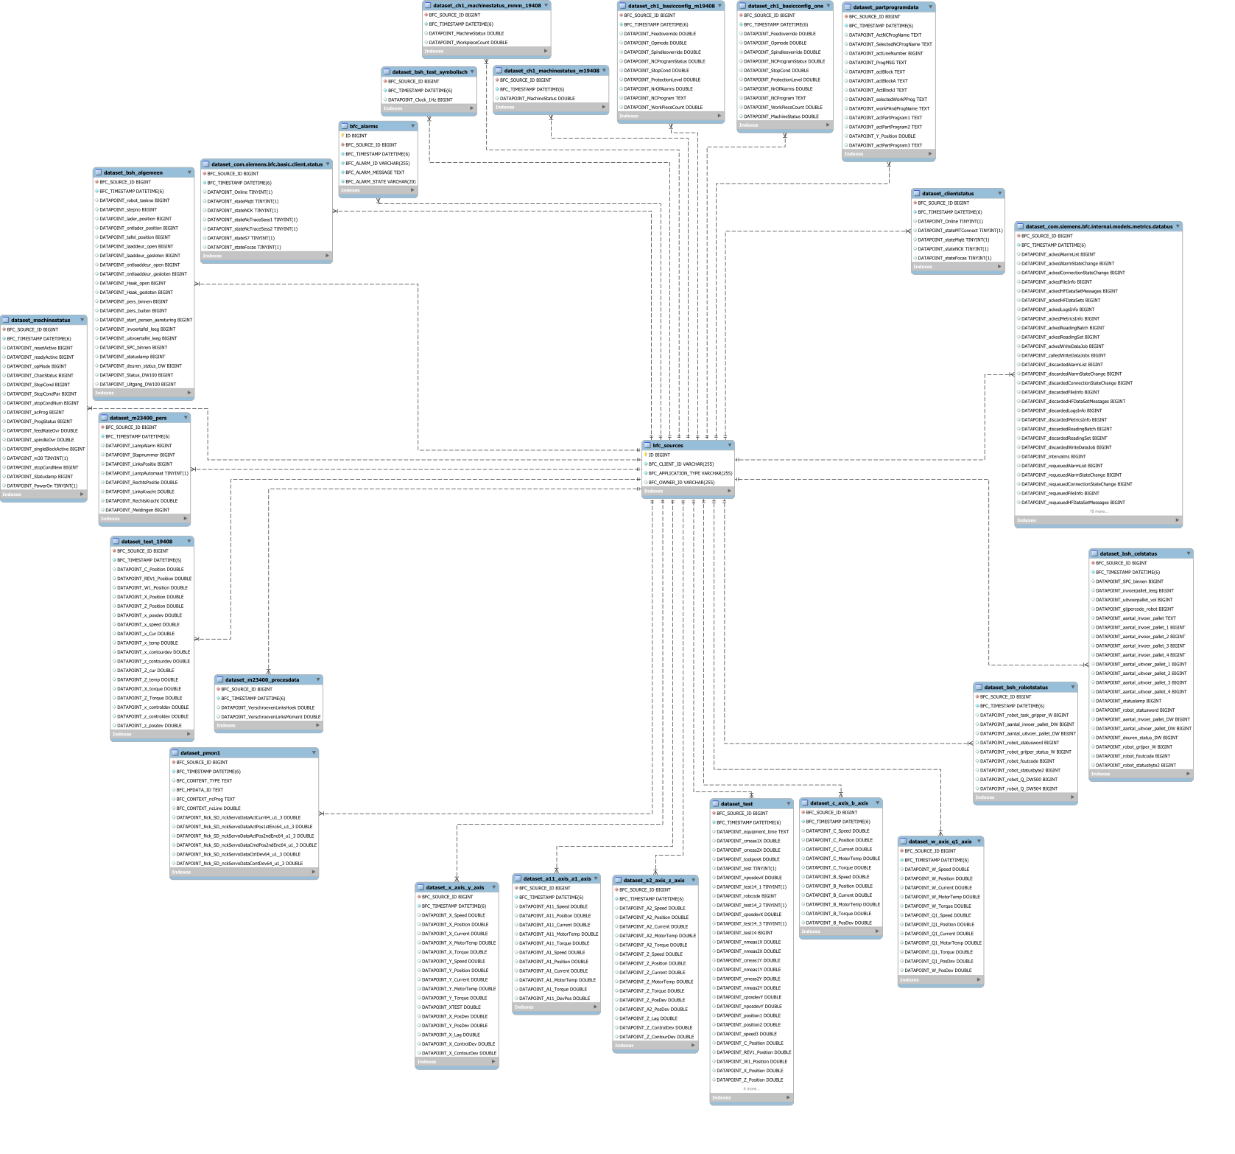
ERD

Slide 5
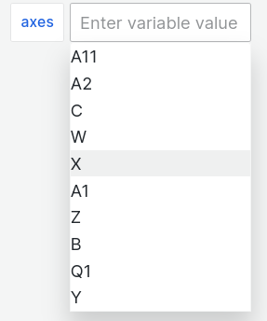
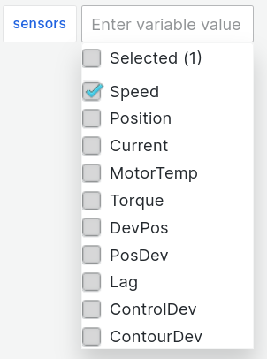
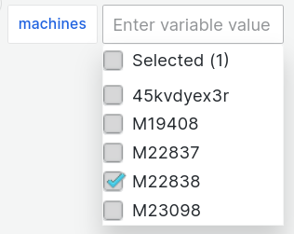
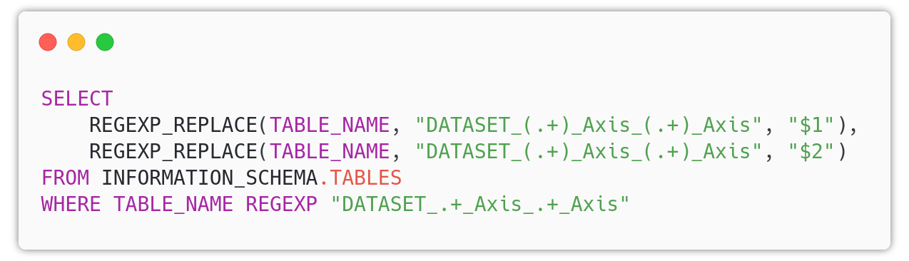
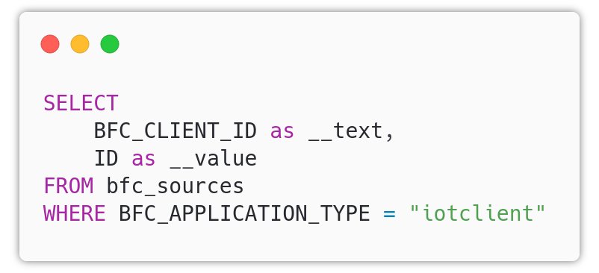
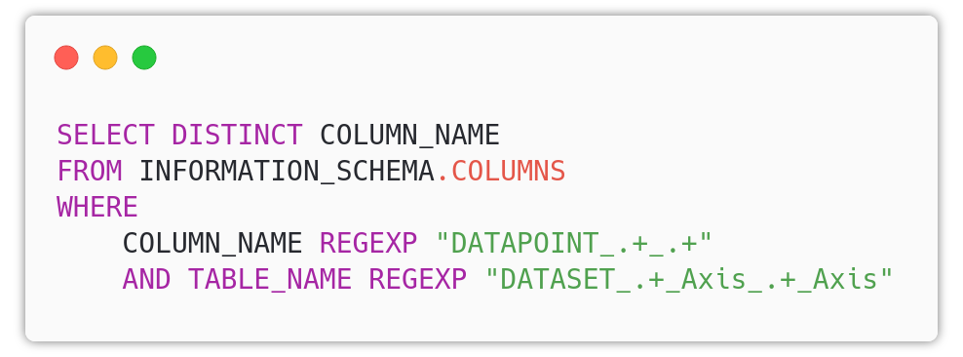
Variables
Notes:
One of the requirements of the solution is usability. For a non-IT employee to generate simple graphs.
For that reason, we dug Grafana documentation.
Variables and templates.
We pulled out the three entities of interest in variables and started looking for ways to make those graphs flexible.
This information is nothing new to you.

Slide 6

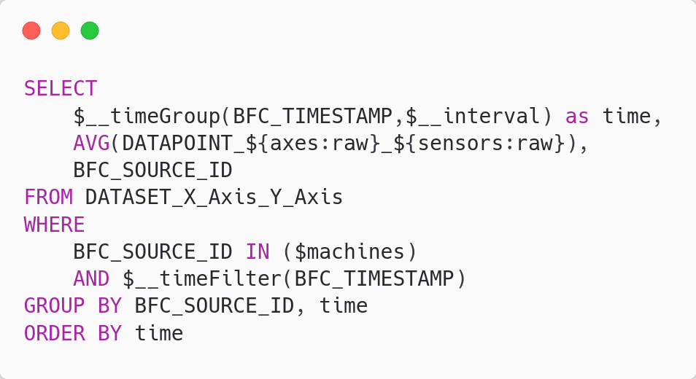
Notes:
This is a small prototype. It is only able to pull a single sensor from a single machine only from the X and Y axis table, but is a good proof of concept and got us up to speed on what is happening and how Grafana visualizes.

Slide 7
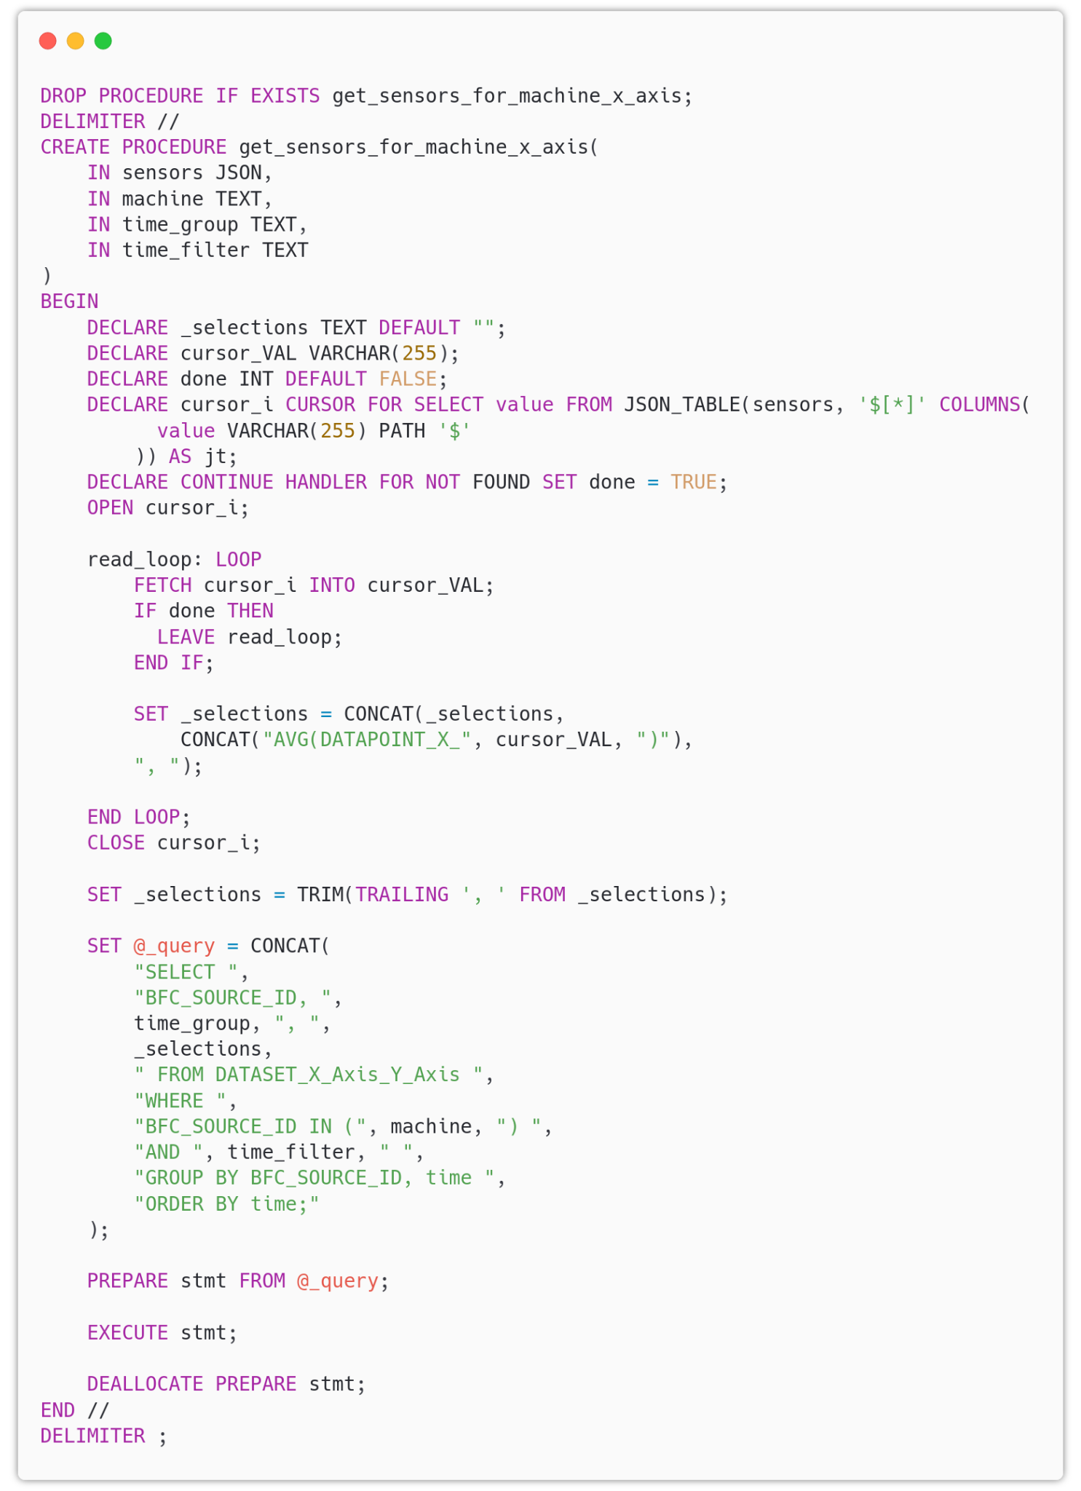
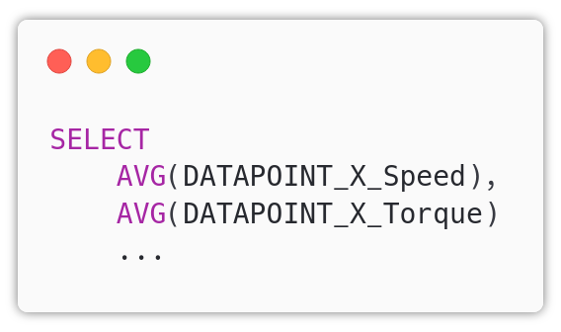
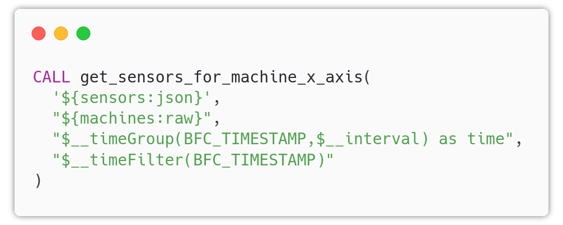
Prepared statements
Notes:
When it comes to selecting more than one axis or sensor, things get more complicated if we want to use those variables and keep things simple but it is not impossible.
Say we want to query more than one sensor for a single axis, the query will have to start like the snippet on the top left. For that task, we couldn’t find any functionality that grafana would provide yet.
One solution is to have prepared statements that will build the query based on the chosen variables. The statement on the right does exactly that. Again, this is just a proof of concept - the final deliverable will be documented and hopefully shorter.
Then we can call it from grafana just like the snippet on the bottom left and still make use of the built-in grafana functions.

Slide 8
Notes:
Here is the proof of concept in action.
We select multiple sensors for the X axis - Speed Position and current. And finally motor temperature and torque.
It would be interesting to see how this would work once we try to select multiple machines, sensors and axes. But as with the proof of concept, it just requires lots of experimentation to see what works best.

Slide 9
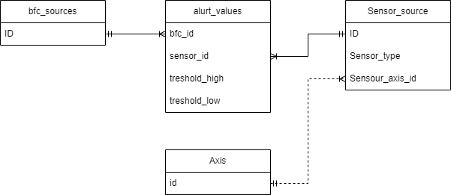
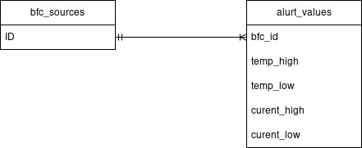
Database expansion

Slide 10
Improving Performance of DAF Queries
Better indexation on the WHERE clauses
Using temporary tables
Reducing the amount of data retrieved by the WHERE clauses
Filtering the data prior joining the tables at the end of the queries
Breaking down the query into a smaller pieces

Slide 11

Now what?
Notes:
As before
Retrospective
Planning
Continue on usability research
Try to get to larger queries with multiple machines/axes/sensors
See what the performance hurdles really are. For now two weeks of data for a single machine is okay
Will get back to you with questions for the usability when I formulate them

Slide 12
Thank you for your time

